Slide 1

Note: The data and information in this document is reflective of a hypothetical situation and client. This document is to be used for KPMG Virtual Internship purposes only.
Sprocket Central Pty Ltd
Data analytics approach
[Division Name] - [Engagement Manager], [Senior Consultant], [Junior Consultant]

Slide 2
Note: The data and information in this document is reflective of a hypothetical situation and client. This document is to be used for KPMG Virtual Internship purposes only.
Agenda
Introduction
Data Exploration – Discovering relationships between data & features
Model Development – Data transformations & modelling
Interpretation – Reporting of key findings

Slide 3
Note: The data and information in this document is reflective of a hypothetical situation and client. This document is to be used for KPMG Virtual Internship purposes only.
Introduction
New Customers’ Analysis
These are the features used for recommendation to the new features:
Age Distributions
Number of purchases in 3 years
Job industry category
Wealth segments
Number of cars owned in each states

Slide 4
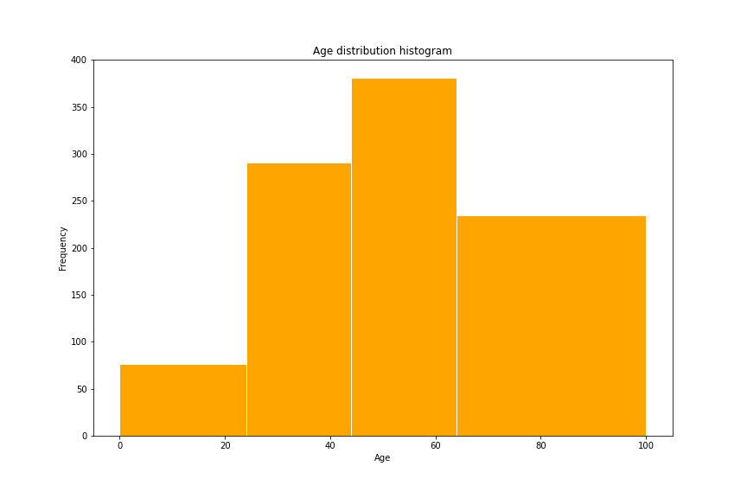
Note: The data and information in this document is reflective of a hypothetical situation and client. This document is to be used for KPMG Virtual Internship purposes only.
Data Exploration
Customers’ Age Distribution
Less than 25% is similar to the original customer groups
There are fewer customers in the age group 25-44.
45-64 age group contains new customers majorly.
There are much more customers in the age group >= 65.

Slide 5
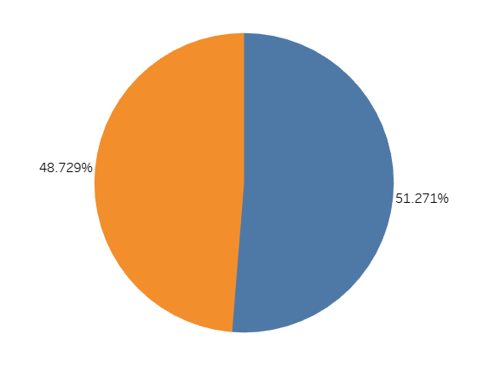
Note: The data and information in this document is reflective of a hypothetical situation and client. This document is to be used for KPMG Virtual Internship purposes only.
Model Development
Bike purchases within the last 3 years
There are slightly more female buyers (51.272%) than male buyers(48.729%).
The distribution of the two groups is very similar, so depending on the marking strategy, you could either try to attract more male buyers or focus on female retention rates.
Male Female

Slide 6
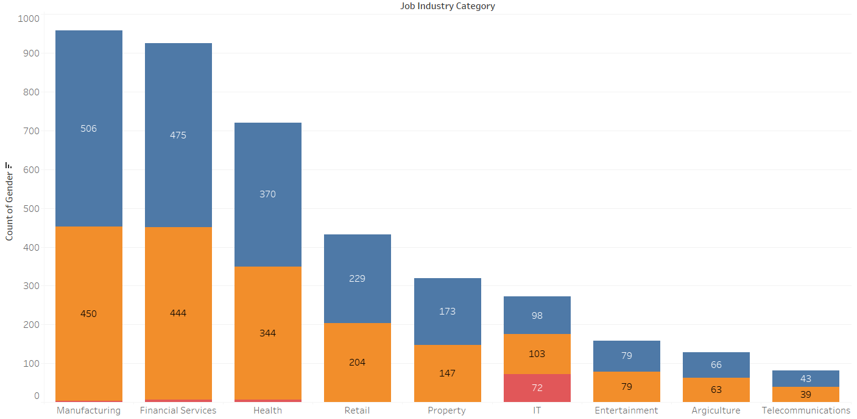
Note: The data and information in this document is reflective of a hypothetical situation and client. This document is to be used for KPMG Virtual Internship purposes only.
Interpretation
Job Industry Category
The top three industry for both the gender groups are: Manufacturing, Financial Services and Health (respectively).

Slide 7
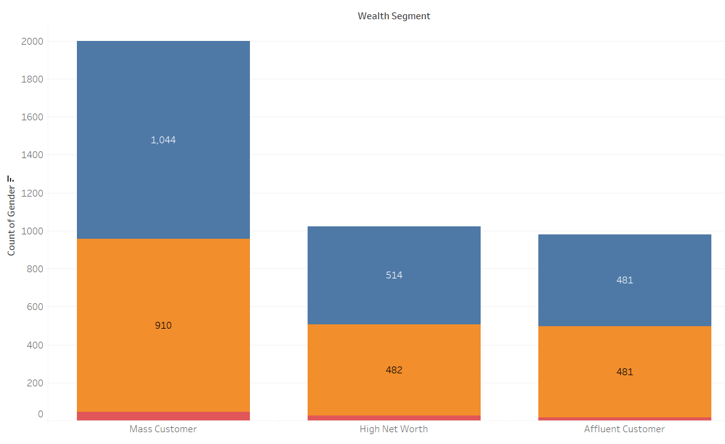
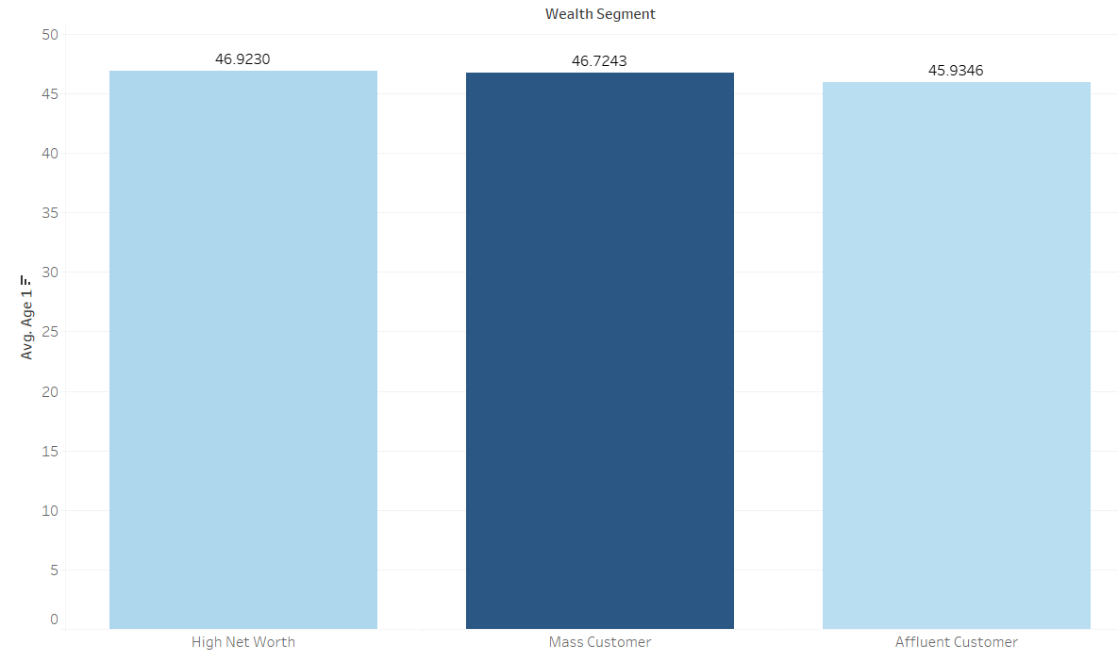
Note: The data and information in this document is reflective of a hypothetical situation and client. This document is to be used for KPMG Virtual Internship purposes only.
Interpretation
Wealth Segments
Average age is same for all wealth segments.
Mass customer segment leads for both the gender groups.
We should focus on focus more on the two aforementioned groups. i.e., High Net Worth & Affluent Customer

Slide 8
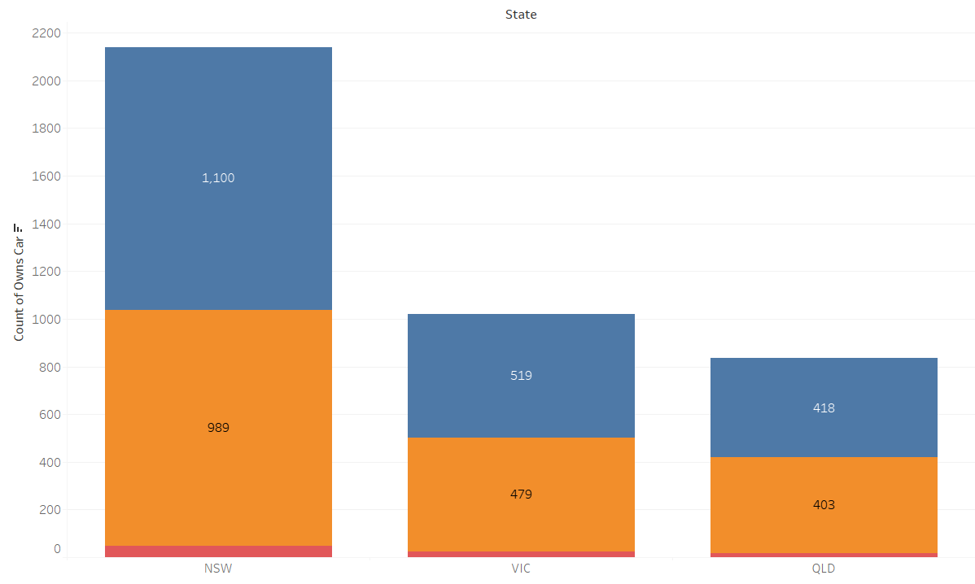
Note: The data and information in this document is reflective of a hypothetical situation and client. This document is to be used for KPMG Virtual Internship purposes only.
Interpretation
Number of cars owned in each state
NSW has the most number of owned cars.
Male gender group owns the highest number of cars in each state.
QLD has the least amount of cars so you can target on that state.

